Slide 1
5- Your First Python Program

Slide 2
context
Create folder 3
Explorer panel 6
Add a new file 7
Recalling a function 8
Text 9
Ex.1 - Built in function | print() 10
Ex.1 (.cont) - Save the changes 11
Ex.1 (.cont) - Integrated terminal in VSCode | Execute the code 12
Ex.2 - Repeat String with * 13

Slide 3
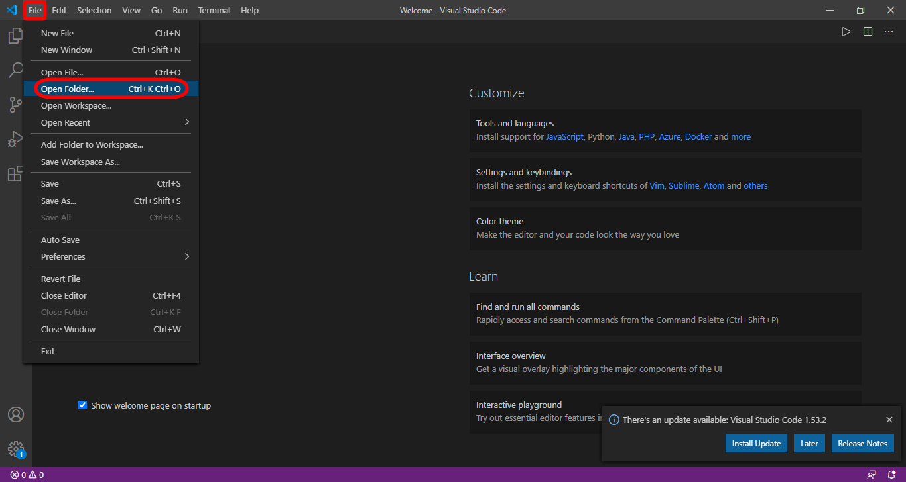

Slide 4
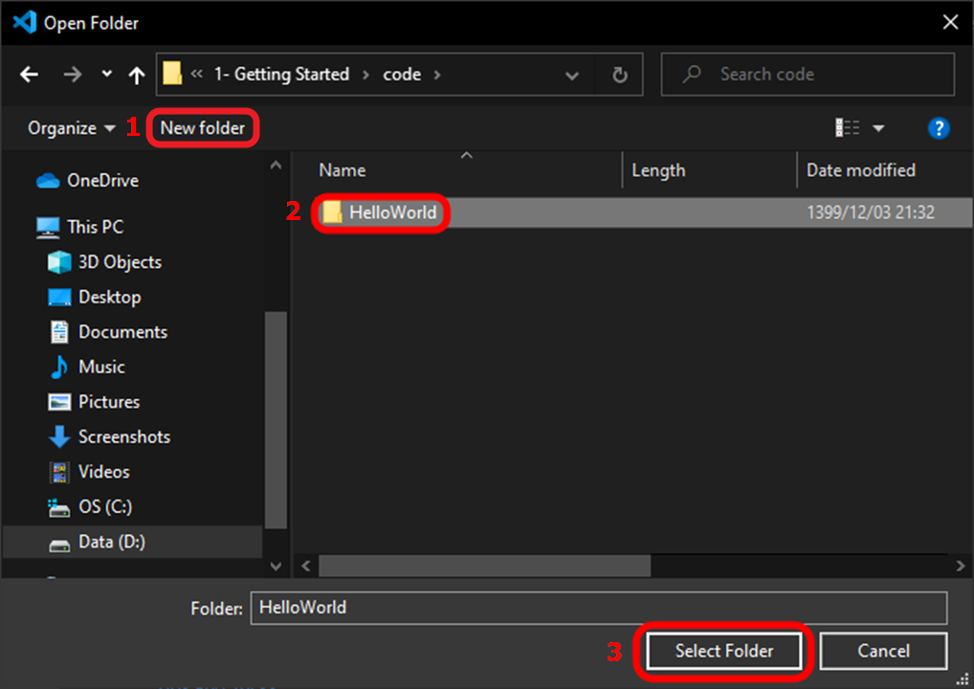

Slide 5
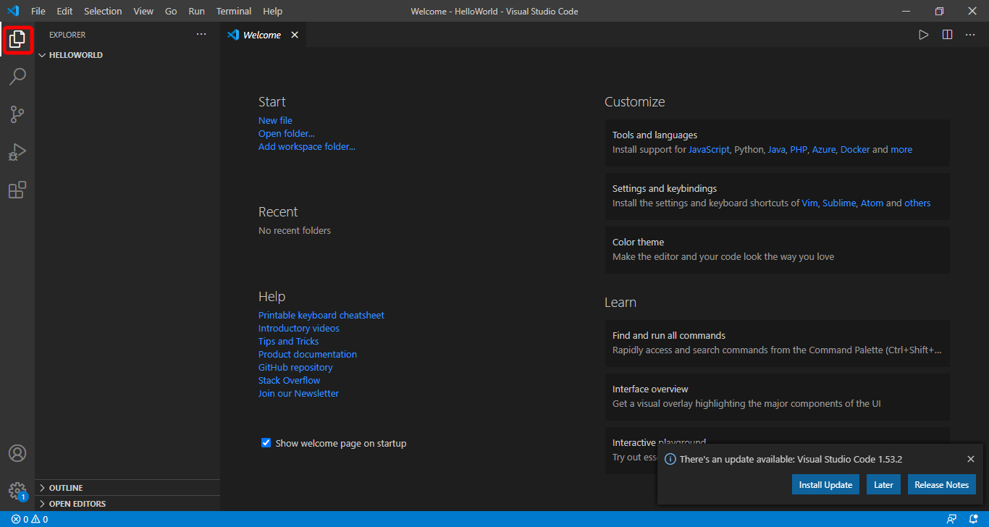
Explorer panel

Slide 6
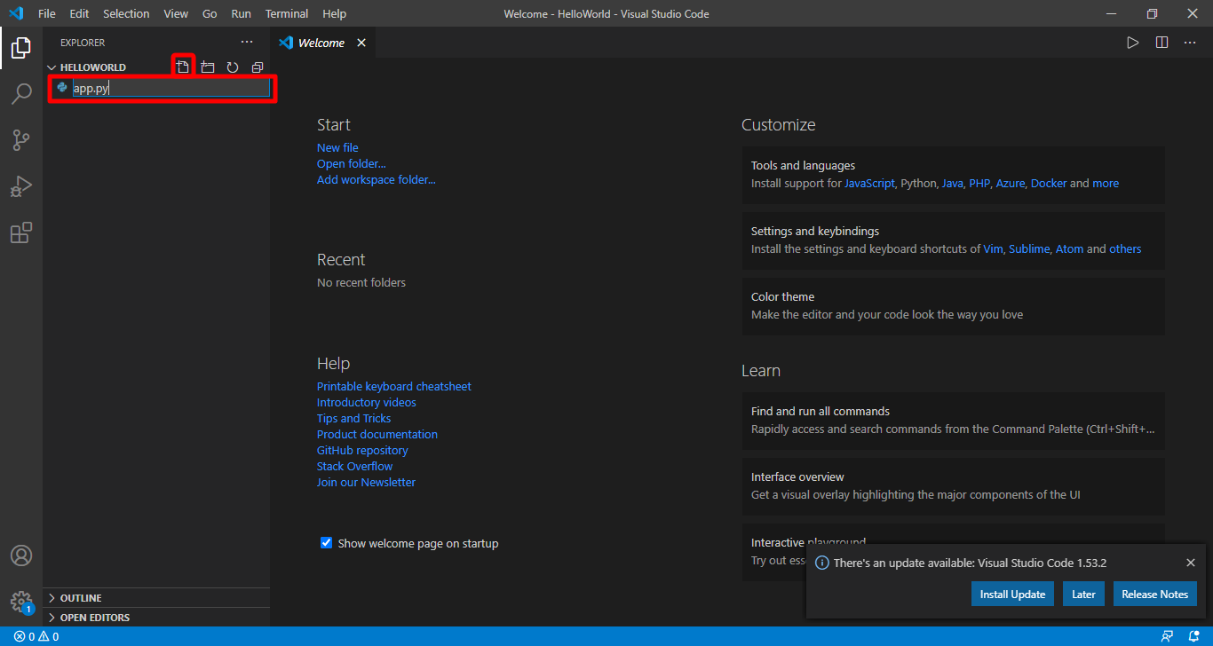
Add a new file “app.py”
all our python files should have the py

Slide 7
Recalling a function
whenever you wanna use a function, you should do this:
FunctionName()
In programming we say recalling the print function
Calling a function means executing it.

Slide 8
text
Whenever you want to work with text, you should put your text in between quotes. In between double quotes or single quotes.

Slide 9
Ex.1 - Built in function | print()
we can use this to print something on the screen

Slide 10
Ex.1 (.cont) - Save the changes
Ctrl + s

Slide 11
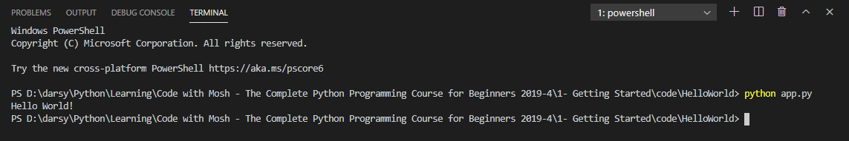
Ex.1 (.cont) - Integrated terminal in VSCode | Execute the code
Open Integrated terminal in VSCode with pressing:
Ctrl + `
Run with typing:
python app.py
To close, press “ Ctrl + ` “ again

Slide 12

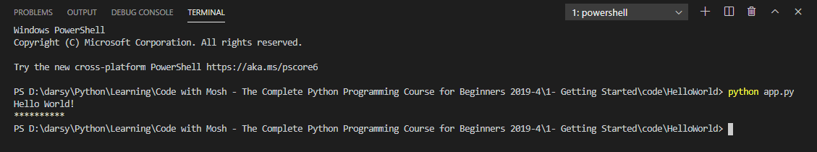
Ex.2 - Repeat String with *

